Slide 1
Comunicação
Rumo à Descoberta:
Envolver Pessoas com Doença na Investigação com Animais
Inês Serrenho
UBI e EARA
Notes:
Para substituir a imagem da capa, siga estes passos:
1.Clique na imagem e vá até “Formatação da Imagem”.
2.Ao lado da opção “Transparência”, selecione o segundo ícone de “Alterar imagem” e escolha um ficheiro.
3.Utilize a opção “Recortar” para ajustar a imagem conforme necessário.
Templates e cores:
-Clique em “Novo Diapositivo”, para mais templates disponíveis.
-Cada tipo de sessão tem uma cor específica para o fundo.
-Para os slides de conteúdo, pode utilizar a cor de fundo da capa ou o tom cinzento.

Slide 2
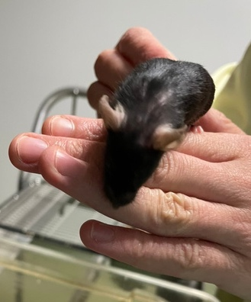

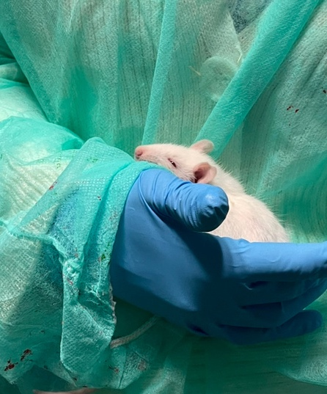
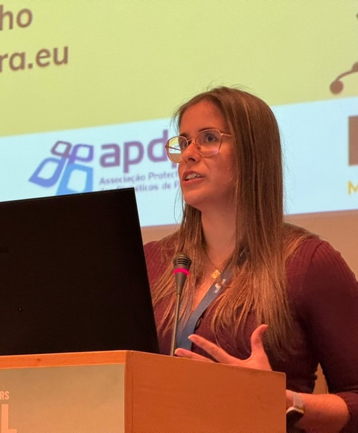
Who am I?
Basic Research
The Science of Fear & Memory 🧠
PhD in Biomedicine
Stem Cells Therapy for Perinatal Asphyxia
Science Communication &
Openness in Animal Research
Notes:
First contact with animals during my master, with lab mice
Animals needed to understand complex processes in the brain
PhD had a strong component of animal research in particular with rats – where I found my love for animals and was hit with the reality of animal research and the misinformation in the public
Focus on ensuring that the public, policymakers, and media hear the full story and know the facts of biomedical research

Slide 3

What is EARA?
EARA is a communications and advocacy organisation to enhance public and regulatory understanding of animal use in research.
EARA has grown substantially since being established in 2014, starting with 7 institutional members, now more than 200!
EARA helps organisations to implement, co-ordinate and maintain nine transparency agreements across the EU and globally (including Portugal)

Slide 4
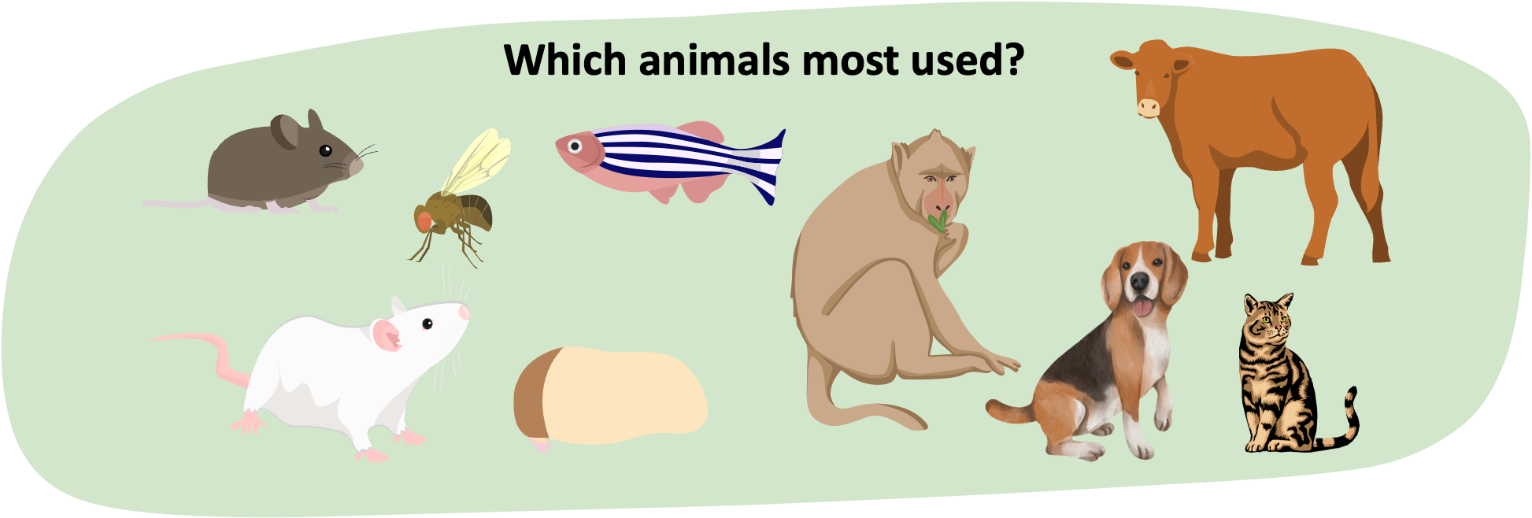
Bridging Science & Society:
Transparency in Animal Research
As a neuroscientist turned science communicator, I’ve seen both sides of the debate and understand the ethical concerns.

Slide 5
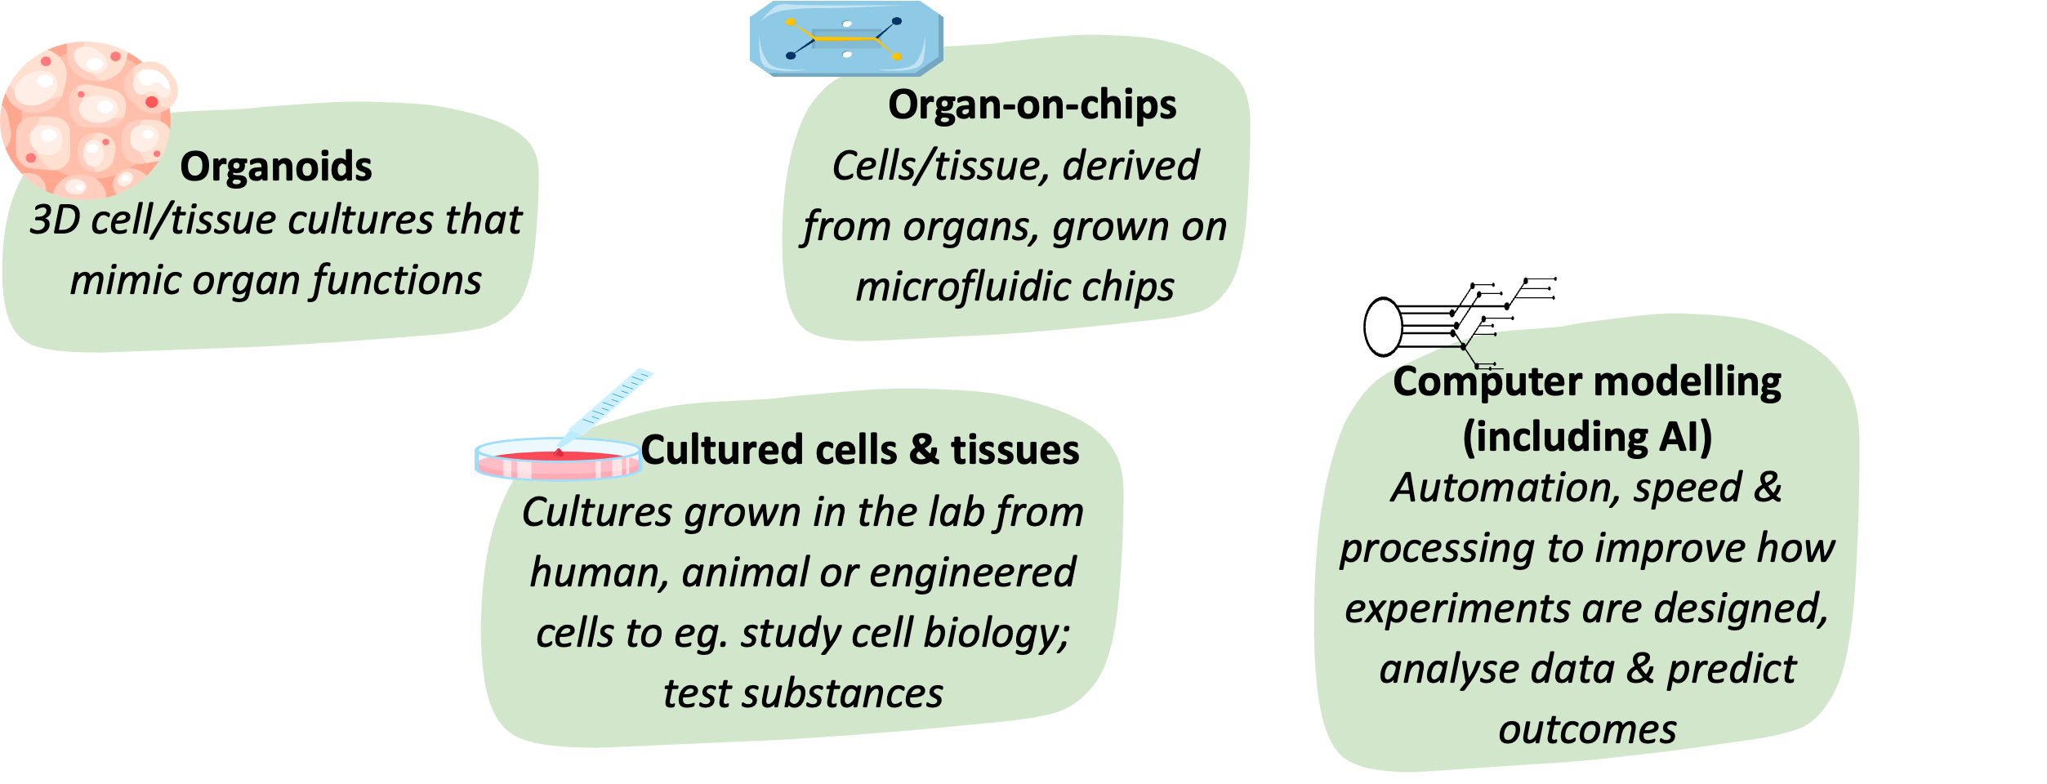
Bridging Science & Society:
Transparency in Animal Research

Slide 6
Bridging Science & Society:
Transparency in Animal Research
We’re making progress—embracing alternatives like organ-on-a-chip and AI-driven models—but science isn’t there yet.
The challenge of replacing animals in research arises from the complexity of the living body.
Non-Animal Methods are still limited in mimicking complex biological systems and interactions.
A combination of techniques and information with animal and non-animal studies can build the best possible understanding. ​

Slide 7
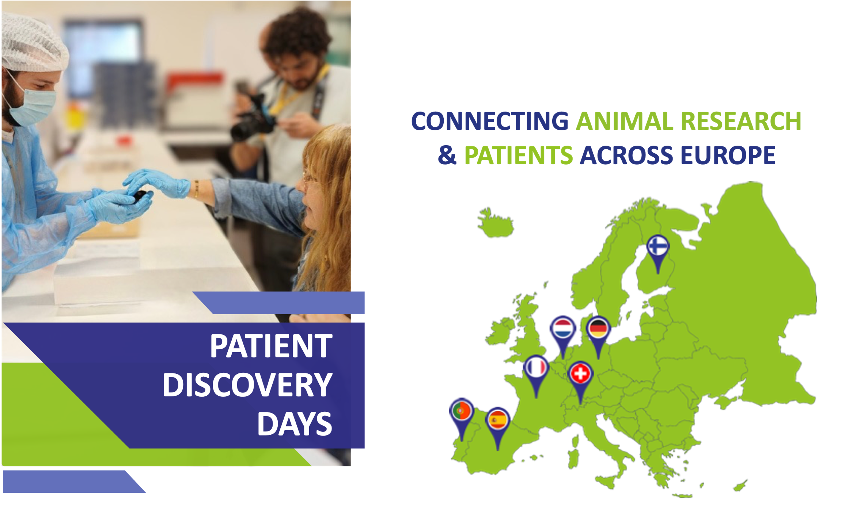
Notes:
Adding the patient voice to engagement on life science research is often talked about but usually finds barriers to be implemented.
Many institutions wanted to put patient groups to the front, on the front line, an easier sell to the public about animal research
EARA was (well in was) against this approach whilst hiding research, not being open was the default position
Now with Transparency Agreements in Animal Research have contributed to a change in institutional culture, EARA believes that now the patient voice can be added to the chorus of those engaging with the public, particularly in the topics of animal research.

Slide 8
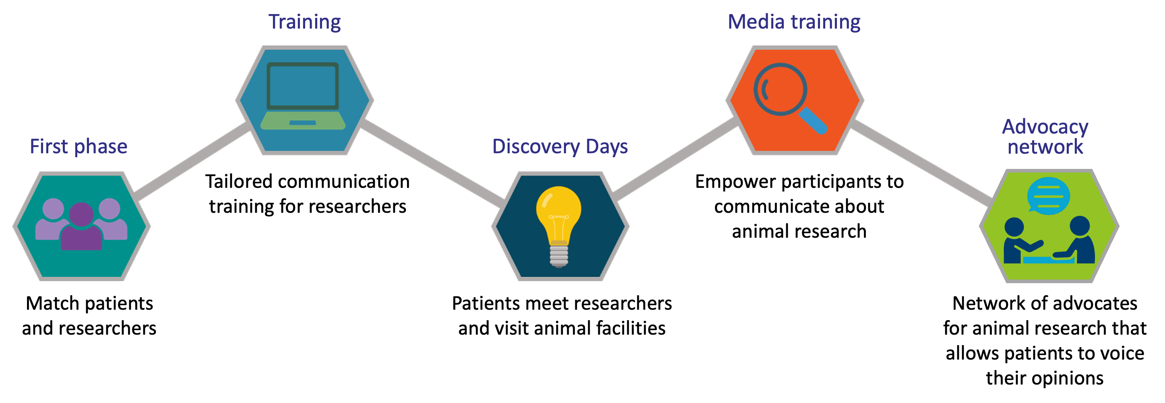
Patient Discovery Project by EARA

Slide 9
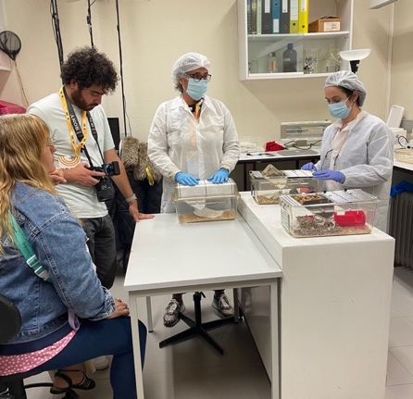
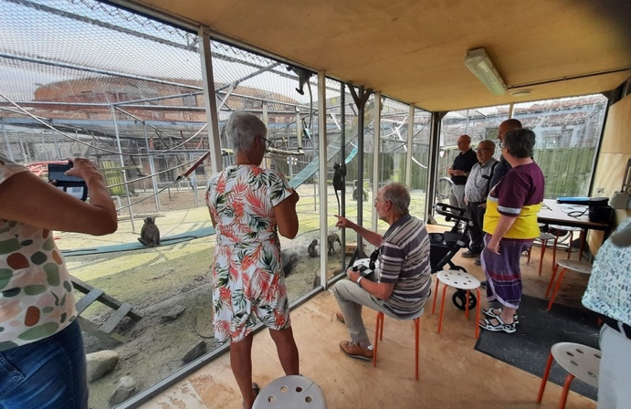
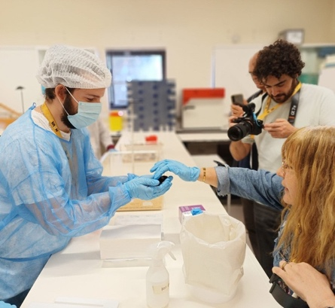
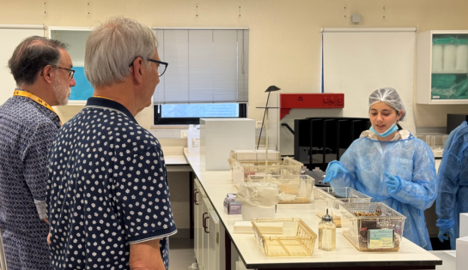
Patient Discovery Project by EARA
Relatable Science
Researchers and participants can share their experiences, creating a narrative that is relatable to others
Building Trust & Transparency
Onsite visits to animal research facilities and open dialogues help dispel myths and demonstrate the strict standards of research with animals

Slide 10
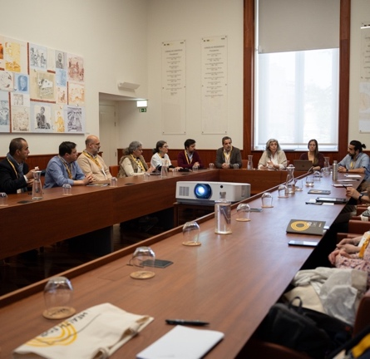
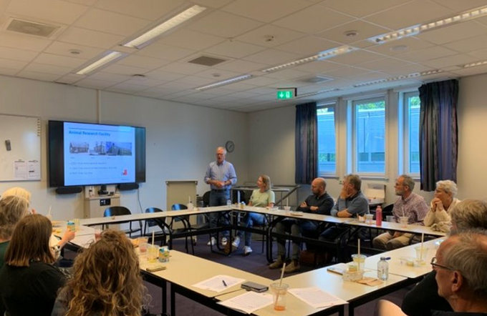
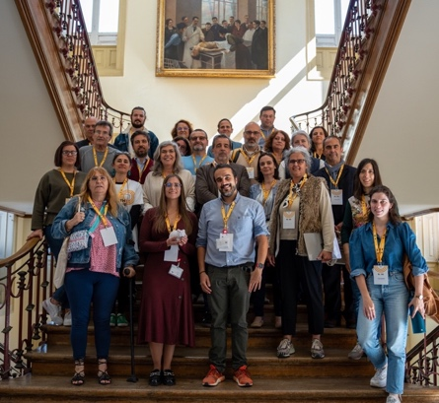
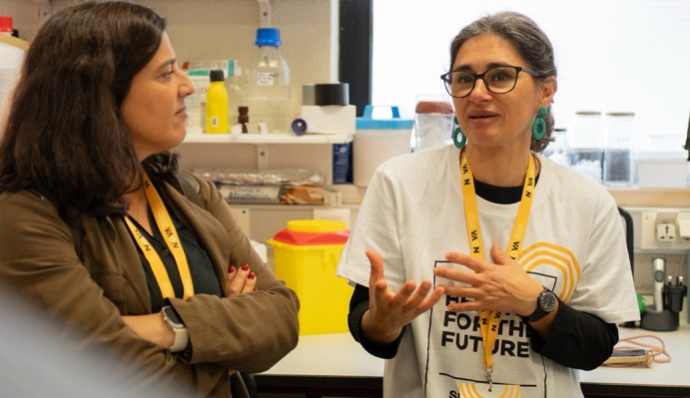
Patient Discovery Project by EARA
Network
Informed patients can become powerful disseminators, influencing public opinion, policy, and funding decisions
Enhancing research relevance
Patient feedback informs research priorities, ensuring studies address what truly matters to those affected

Slide 11
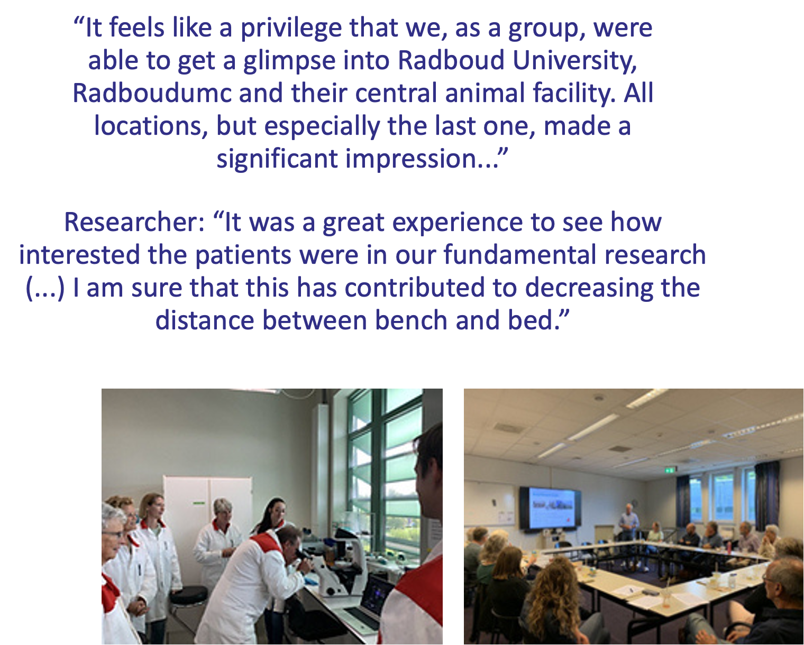
Parkinson Discovery Day, The Netherlands
Toolkit to understand Parkinson’s Disease
Talks about Parkinson’s research using cell models, animal models, toxicology, neurotechnology and imaging techniques
Tours to the Radboud University
Onsite visits to the cell culture lab, the biochemical lab, and the animal facility which has different non-invasive scanner set-ups for behavioural studies with rats and mice

Slide 12
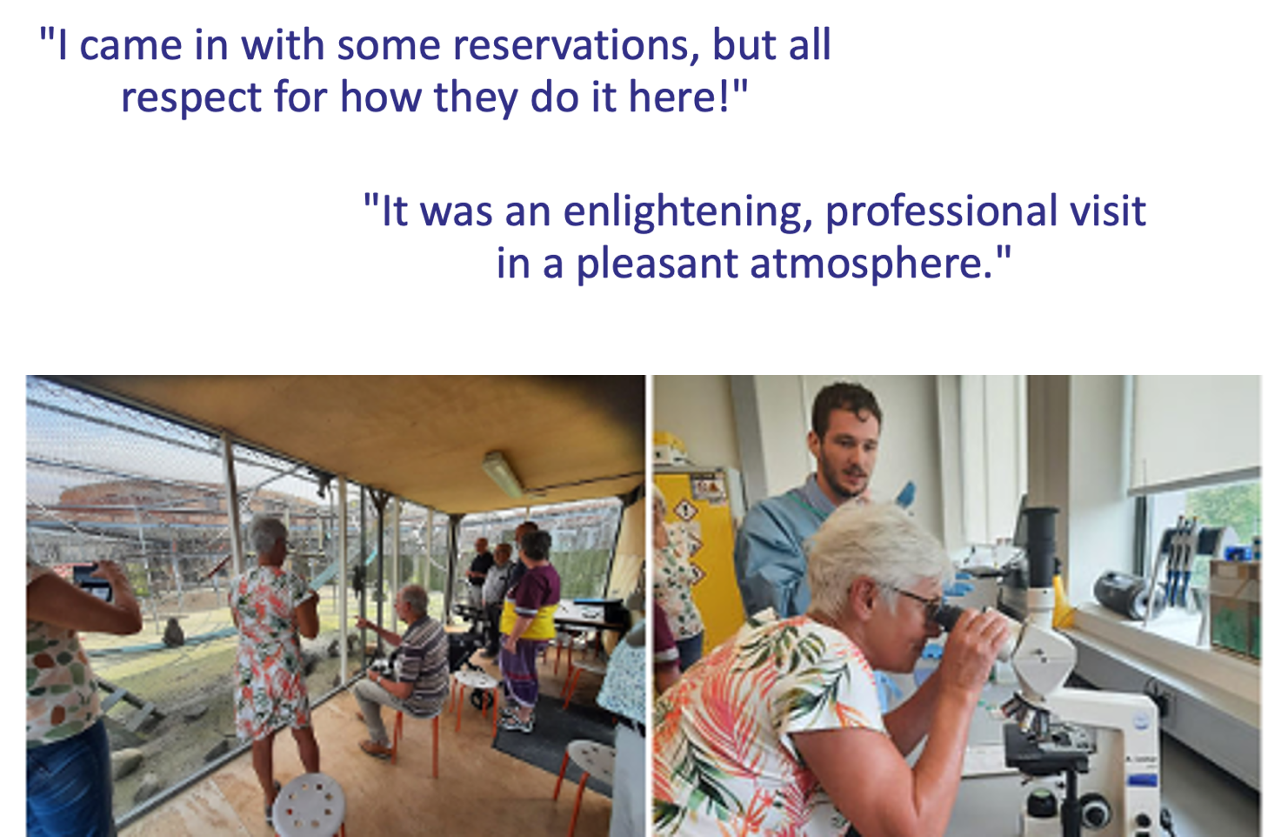
Parkinson Discovery Day, The Netherlands
Talks about research methods using primates and its alternatives
Foster a balanced understanding of approaches used to advance brain research and develop new treatments
Tours of the primate facilities at BPRC
Attendees were shown the extensive welfare measures, enriched housing and training protocols that help animals participate willingly in research tasks

Slide 13
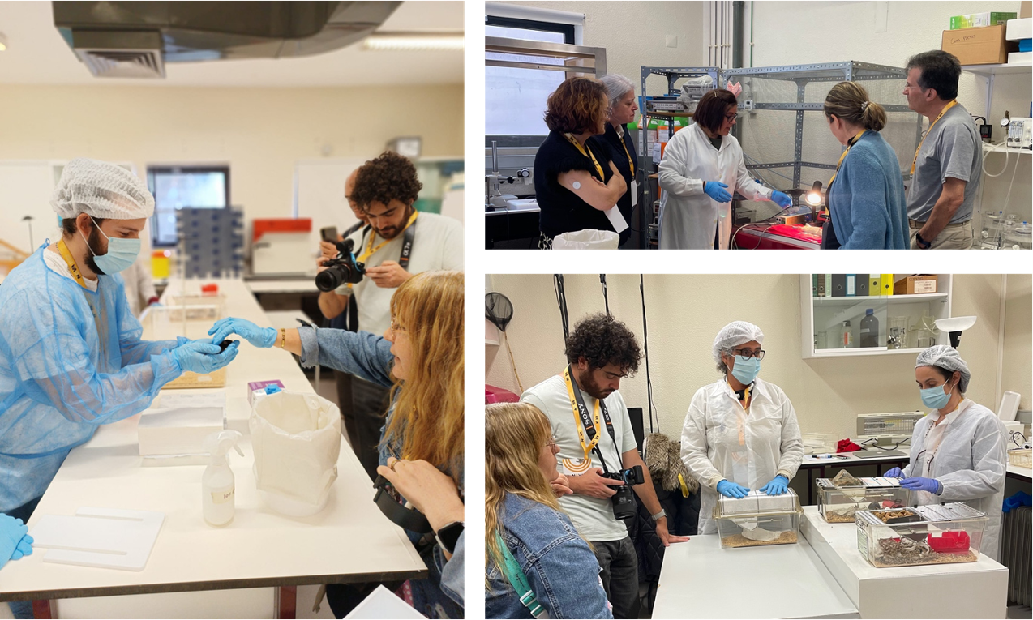
Diabetes Discovery Day, Portugal
Diabetes research methods at NMS
Research on Type 2 Diabetes incorporates animal models, particularly mice and rats
Tours of the animal facilities
Insights on how diabetes is induced in mice and rats by manipulating their diet, welfare measures, behavioural tests, blood glucose measurements, and live-surgical interventions

Slide 14
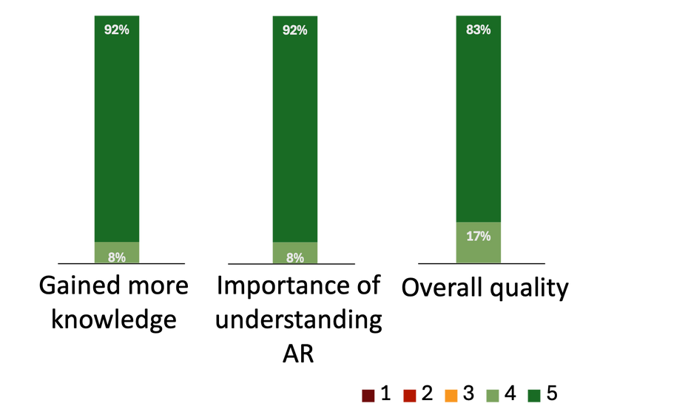
Diabetes Discovery Day, Portugal
“I did not imagine that there were so many research lines in diabetes and the passion of the researchers working with animals really surprised me."
“It surpassed expectations, with the openness on the questions we asked. This research I was able to witness is not separated from patients. And the animals are well taken care of.”
"I have always thought scientists made sure animals were not suffering during experiments, but I was greatly surprised with the extreme amount of care from the researchers towards the animals.”

Slide 15
Next steps
Enhance visibility and impact
  Increase dissemination of the project
  Give or create opportunities for patients to use their voices and share insights
  Partner with new researchers and patient groups

Slide 16
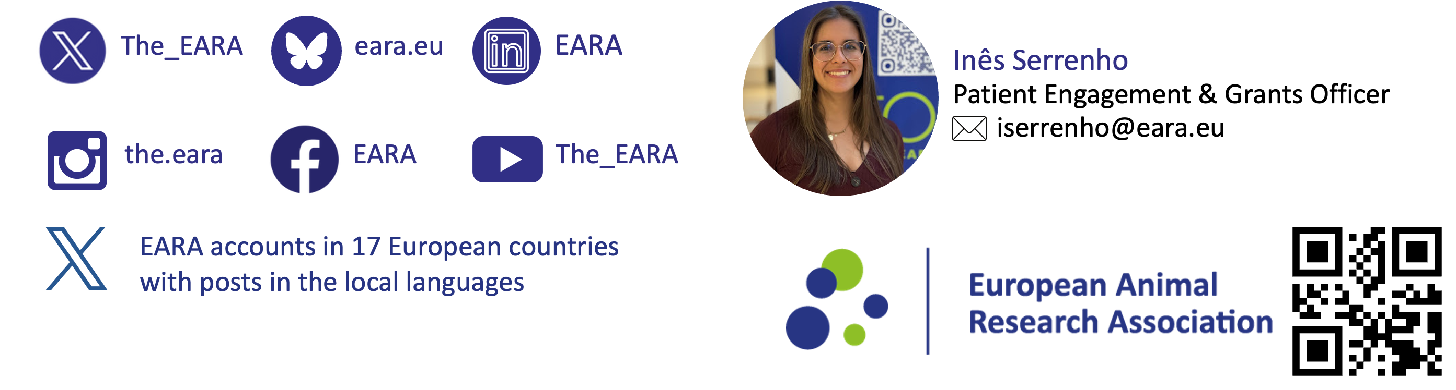
Obrigada!

